Slide 1
CSI 5112
Change Management and
Software Configuration Management
“Version control is the art of managing changes to information. It has long been a critical tool for programmers, who typically spend their time making small changes to software and then undoing those changes the next day.”
Based on material from:
Bruegge and Dutoit (chapter 13),
RCS/CVS/Bugzilla Web Sites,
CVS Poket Reference (O’Reilly),
Telelogic

Slide 2
Dealing with Real Software…
  I’m pretty sure I have fixed that bug. Why is it back?
  Oops! The latest version got overwritten by an older version…
  How can I go back to the previous version, you know, the one that was stable?
  The design document is out of sync with programs…
  I don’t know if all the changes that were suggested have been incorporated!
  Which version is the right one? We have so many!
  For this customer, I’d like to use this special component instead of the regular one…
Change Management and Software Configuration Management

Slide 3
Outline
Change Management
  Overview in a requirements engineering context
Purpose of Software Configuration Management (SCM)
  Motivation, definitions, activities
Some Terminology
  Configuration Item, Baseline, SCM Directory, Version, Revision Release.
Software Configuration Management Activities
  Promotion Management, Release Management, Change Management
Outline of a Software Configuration Management Plans
  Standards (Example: IEEE 828-1990)
Configuration/Change Management Tools
  Introduction to RCS, CVS, Bugzilla
Change Management and Software Configuration Management

Slide 4
Introduction to Change Management
If you see change not as an enemy, but as a welcome friend, you will secure the most valuable prize of all – the future…

Slide 5

Change Management and Software Configuration Management

Slide 6
Change is Inevitable
All Projects are subject to change… a high risk challenge
  Increasing number of contributors & stakeholders
  Agility needs reactivity
  Usability is key
Change may impact the agreed baseline of Requirements
  Need a formal organization-tuned process
  Assess, decide, communicate
Change traceability
  Relate project Development activities to Requirements and Change Management decisions
  Establish a full audit trail
  Need to record and manage change impacting all project artifacts
Change Management and Software Configuration Management
Notes:
Changes in requirements are one of the more riskier moments in a project’s lifecycle (communication issues, inconsistencies…) but also a major challenge for organizations who want to be reactive and customer focused (tell the customer “too bad, we’ve frozen the requirements, change your mind for the next release” ???)

Slide 7





Change Management
Raw Information
Integrated Requirements Gathering
Requirements Driven Testing
User Requirements
Specification
Acceptance
testing
Functional
Specification
Change
System testing
Design
Integration
testing
Requirements Driven Development
Integrated Defect Management
System Build
Change Management and Software Configuration Management

Slide 8
Change Management
Focuses on procedures, processes and standards used to manage changes to requirements, code, and other artefacts.
Change management policies can describe:
  The process for requesting changes and required information
  The process to be used to analyse the cost, benefits, and impact of the proposed change (need traceability)
  Who will approve the request, and how
  Software support (tools)
A change request can have a status (state), like requirements
  E.g.: Proposed, rejected, accepted, postpones, incorporated…
Change Management and Software Configuration Management

Slide 9











Sample Requirements Change Request Process
Changes are
proposed against
requirements
Proposed changes
are assessed
and approved
Proposed changes
are applied
Change Management and Software Configuration Management
Notes:
Multiple engineers can work on the same RCP

Slide 10
Some Tools for Change Management
Can be standalone, or more likely integrated to another tool
  Requirements management tool, configuration management tool…
Typical functionalities
  Electronic forms for requesting changes
  Database for storing and managing requests
  A change model, in line with the change process
  Links to other artifacts, enabling impact analysis
  E-mail notification (for each phase)
  Electronic signatures
  Discussion forums
  Etc.
Change Management and Software Configuration Management

Slide 11
Example: DOORS CPS and Synergy
DOORS Change Proposal System (CPS)
  Integrated to the requirements management system
  Supports change proposal and evaluation
  Limited in flexibility
DOORS/SYNERGY
  Integrated with autonomous change/version management system
  More complex, but more flexible and covers all phases of development cycle
Change Management and Software Configuration Management

Slide 12
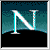
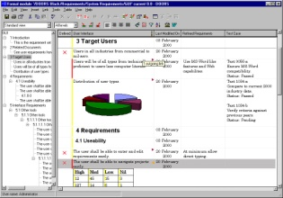
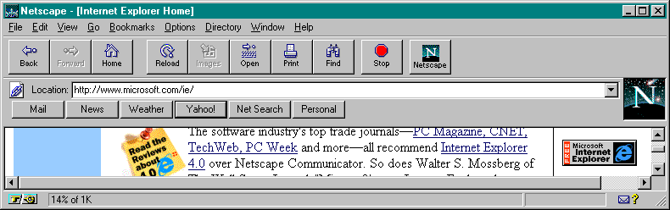
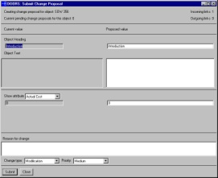

DOORS: Change Proposal System
E-mail
Changes from all
users including
DOORSnet
Submitted
Accepted
Changes reviewed
on-line
Read-only
user submits
“Change Proposal”
In Review
Further Research
Next Release
On Hold
Rejected
Change Management and Software Configuration Management

Slide 13
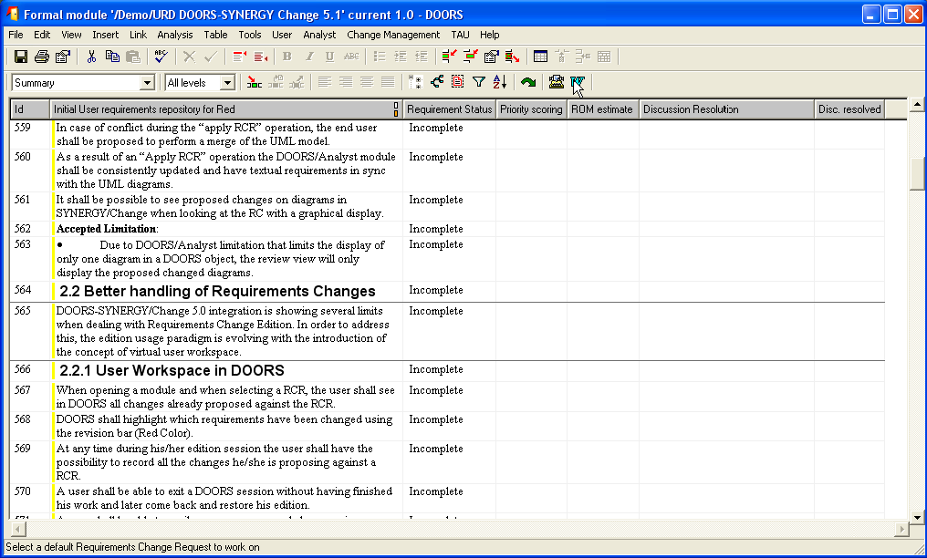
DOORS/SYNERGY
Ordinary DOORS module
Change Management and Software Configuration Management

Slide 14
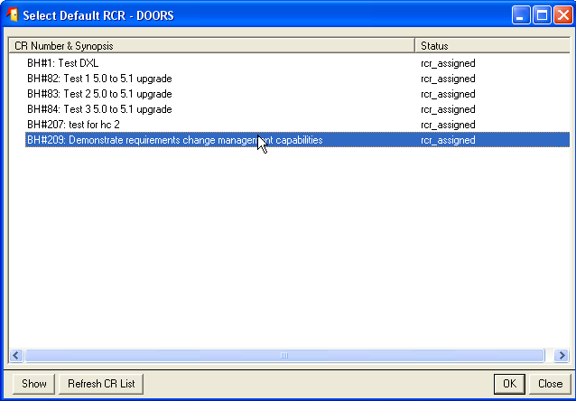
DOORS/SYNERGY
Select a change proposal in SYNERGY
Change Management and Software Configuration Management

Slide 15
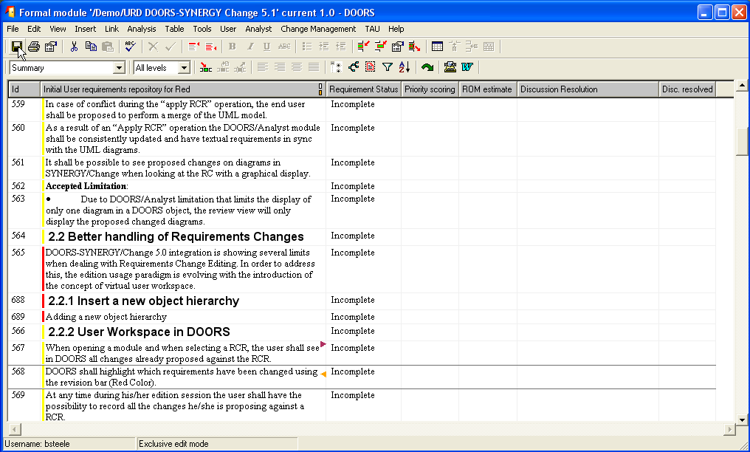
DOORS/SYNERGY
Do appropriate changes
Change Management and Software Configuration Management

Slide 16
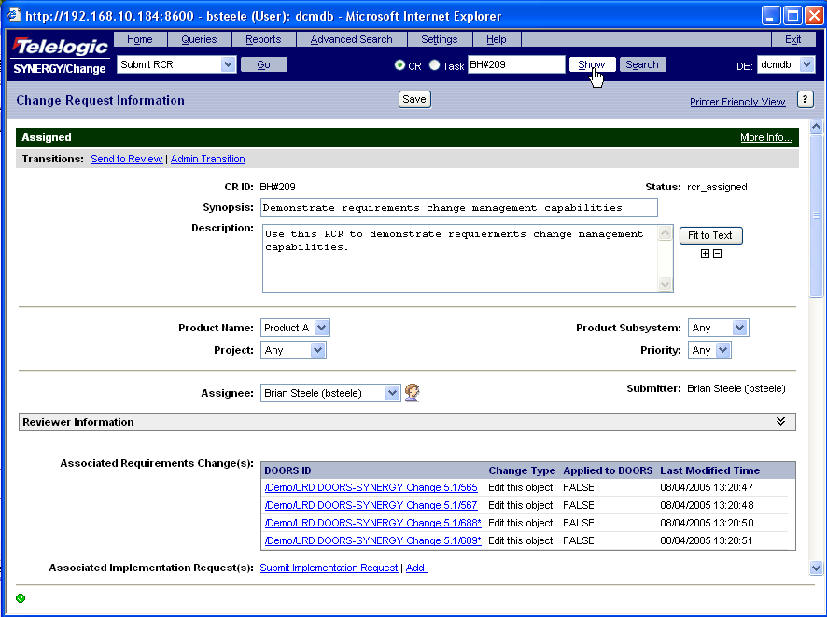
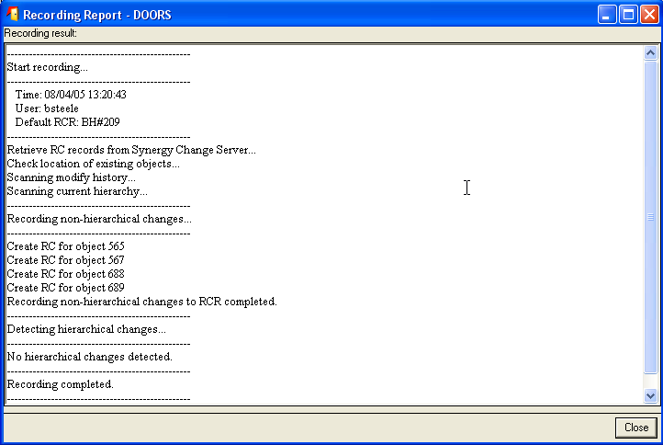
DOORS/SYNERGY
Changes managed by SYNERGY/Change
Change Management and Software Configuration Management

Slide 17
Several Aspects in Management
… of change
  Who submits change requests, and how?
  How are these requests monitored, prioritised, implemented?
… of configurations
  Version, labels, and code monitoring during the software lifecycle.
… of releases
  Describes how and when the software and hardware components will become available as a product
Change Management and Software Configuration Management

Slide 18
Software Configuration Management

Slide 19
Why Software Configuration Management ?
The problem:
  Multiple people have to work on software that is changing
    Teams can also be distributed
    Avoid multiple copies, avoid clashing updates
  More than one version of the software has to be supported:
    Released systems
    Custom configured systems (product families)
    System(s) under development
  Software must run on different machines and operating systems
Need for coordination!
Software Configuration Management (SCM)
  Manages evolving software systems
  Controls the costs involved in making changes to a system
Change Management and Software Configuration Management

Slide 20
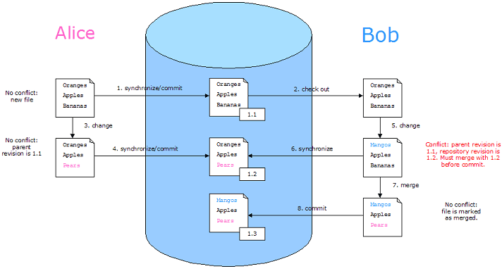
Conflict Example, in a Nutshell...
Change Management and Software Configuration Management

Slide 21
What is Software Configuration Management?
Definition:
  A set of management disciplines within the software engineering process to develop a baseline.
Description:
  Software Configuration Management encompasses the disciplines and techniques of initiating, evaluating and controlling change to software products during and after the software engineering process.
Some standards:
  IEEE 828: Software Configuration Management Plans
  IEEE 1042: Guide to Software Configuration Management
  ISO/IEC 12207: Information Technology-Software Life Cycle Processes
Change Management and Software Configuration Management

Slide 22
Software Configuration Management as a Project Function
SCM is a project function with the goal to make technical and managerial activities more effective.
  Not a goal of the product in itself
SCM can be administered in several ways:
  A single software configuration management team for the whole organization
  A separate configuration management team for each project
  Software configuration management distributed among the project members
  Mixture of all of the above
Change Management and Software Configuration Management

Slide 23
Configuration Management Activities
Configuration item identification
  modeling of the system as a set of evolving components
Promotion management
  is the creation of versions for other developers
Release management
  is the creation of versions for the clients and users
Change management
  is the handling, approval and tracking of change requests
Branch management
  is the management of concurrent development
Variant management
  is the management of versions intended to coexist
…
Change Management and Software Configuration Management

Slide 24
Configuration Management Activities
Build management (often included)
  Automatic compilation minimizing the amount of recompilation and handling multiple variants/combinations of components.
  May include automated documentation generation and unit/integration testing.
  Example: Tools for continuous integration
    CruiseControl, http://cruisecontrol.sourceforge.net/
    Hudson, https://hudson.dev.java.net/
Automated auditing (becomes popular)
  Checks the code against standards (quality metrics, architectural constraints, policies, etc.) before accepting it.
No fixed rules!
Activities are usually performed in different ways (formally, informally) depending on the project type and life-cycle phase (research, development, maintenance).
Change Management and Software Configuration Management

Slide 25
Configuration Management Roles
Configuration manager
  Responsible for identifying configuration items. The configuration manager can also be responsible for defining the procedures for creating promotions and releases.
Change control board member
  Responsible for approving or rejecting change requests.
Developer
  Creates promotions triggered by change requests or the normal activities of development. The developer checks in changes and resolves conflicts.
Auditor
  Responsible for the selection and evaluation of promotions for release and for ensuring the consistency and completeness of this release.
Change Management and Software Configuration Management

Slide 26
Terminology
IEEE standard terminology
  Configuration Item
  Baseline
  SCM Directories
  Version
  Revision
  Release
Different configuration management systems may use different terms.
  Example: the CVS configuration management system uses terms different from the IEEE standard.
Change Management and Software Configuration Management

Slide 27
Terminology: Configuration Item
“An aggregation of hardware, software, or both, that is designated for configuration management and treated as a single entity in the configuration management process.”
Software configuration items are not only program code segments but all type of documents according to development, e.g.:
  all type of code files
  drivers for tests
  analysis or design documents
  user or developer manuals
  system configurations (e.g. version of compiler used)
In some systems, not only software but also hardware configuration items (CPUs, bus speed frequencies) exist!
Change Management and Software Configuration Management

Slide 28
Tasks for the Configuration Managers
Define configuration items
Change Management and Software Configuration Management

Slide 29
Finding Configuration Items
Large projects typically produce thousands of entities (files, documents, data ...) which must be uniquely identified.
Any entity managed in the software engineering process can potentially be brought under configuration management control
But not every entity needs to be under configuration management control all the time.
Two Issues:
  What: Selection of Configuration Items (CIs)
    What should be under configuration control?
  When:
    When do you start to place entities under configuration control?
Conflict for the Project Manager:
  Starting with CIs too early introduces too much overhead
  Starting with CIs too late introduces chaos
Change Management and Software Configuration Management

Slide 30
Finding Configuration Items (continued)
Some items must be maintained for the lifetime of the software.
  This includes also the maintenance phase, when the software is no longer developed but still in use (perhaps by industrial customers who are expecting proper support for many years).
An entity naming scheme should be defined so that related documents have related names.
  Having metadata attached to CIs can also help.
Selecting the right configuration items is a skill that takes practice
  Use techniques similar to object modeling for finding CIs!
    Find the CIs
    Find relationships between CIs
Change Management and Software Configuration Management

Slide 31
Which of these Entities should be Configuration Items?
Problem Statement
Software Project Management Plan (SPMP)
Requirements Analysis Document (RAD)
System Design Document (SDD)
Project Agreement
Object Design Document (ODD)
Dynamic Model
Object model
Functional Model
Unit tests
Integration test strategy
Source code
API Specification
Input data and databases
Test plan
Test data
Support software (part of the product)
Support software (not part of the product)
User manual
Administrator manual
Change Management and Software Configuration Management

Slide 32
Possible Selection of Configuration Items
Problem Statement
Software Project Management Plan (SPMP)
Requirements Analysis Document (RAD)
System Design Document (SDD)
Project Agreement
Object Design Document (ODD)
Dynamic Model
Object model
Functional Model
Unit tests
Integration test strategy
Source code
API Specification
Input data and databases
Test plan
Test data
Support software (part of the product)
Support software (not part of the product)
User manual
Administrator manual
Once the Configuration Items are selected,
they are usually organized in a tree
Change Management and Software Configuration Management

Slide 33
Configuration Item Tree (Example)
“The project” CI
Models
Subsystems
Documents
Object Model
Dynamic Model
RAD
ODD
. . . .
Database
User Interface
. . . .
. . . .
Code
Data
Unit Test
. . . .
Change Management and Software Configuration Management

Slide 34
Tasks for the Configuration Managers
Define configuration items
Define promote/release policies
Change Management and Software Configuration Management

Slide 35
Terminology: Version
“The initial release or re-release of a configuration item associated with a complete compilation or recompilation of the item. Different versions have different functionality.”
Change Management and Software Configuration Management

Slide 36
Terminology: Baseline
“A specification or product that has been formally reviewed and agreed to by responsible management, that thereafter serves as the basis for further development, and can be changed only through formal change control procedures.”
Examples:
  Baseline A: All the API have completely been defined; the bodies of the methods are empty.
  Baseline B: All data access methods are implemented and tested.
  Baseline C: The GUI is implemented.
Change Management and Software Configuration Management

Slide 37
More on Baselines
As systems are developed, a series of baselines is developed, usually after a review (analysis review, design review, code review, system testing, client acceptance, ...)
  Developmental baseline (RAD, SDD, Integration Test, ...)
    Goal: Coordinate engineering activities.
  Functional baseline (first prototype, alpha release, beta release)
    Goal: Get first customer experiences with functional system.
  Product baseline (product)
    Goal: Coordinate sales and customer support.
Many naming scheme for baselines exist (1.0, 6.01a, ...)
A 3 digit scheme is quite common:
7.5.5
Release
(Customer)
Version
(Developer)
Revision
(Developer)
Change Management and Software Configuration Management

Slide 38
Baselines in Iterative Processes
BASE LINES
Detailed
design
Design
doc
Req specs
TIME
Req HLD LLD IMP MAINT
Phase Phase Phase Phase Phase
First release of Baseline
Second release of Baseline
Change Management and Software Configuration Management

Slide 39
Change Management
Change management is the handling of change requests
  A change request leads to the creation of a new version/release
General change process
  The change is requested (this can be done by anyone including users and developers)
  The change request is assessed against project goals
  Following the assessment, the change is accepted, postponed (to a later phase), or rejected
  If it is accepted, the change is assigned to a developer and implemented
  The implemented change is audited.
The complexity of the change management process varies with the project. Small projects can perform change requests informally and fast while complex projects require detailed change request forms and the official approval by one more managers.
Change Management and Software Configuration Management

Slide 40



Controlling Changes
Two ways of controlling change:
  Promotion: The internal development state of a software is changed.
  Release: A changed software system is made visible outside the development organization.
Approaches for controlling change (Change Policy)
  Informal (good for research type environments and promotions)
  Formal approach (good for externally developed CIs and for releases)
Promote
Policy
Release
Policy
User
Programmer
Master
Directory
Software Repository
Promotion
Release
Change Management and Software Configuration Management

Slide 41
Terminology: SCM Directories
Programmer’s Directory (IEEE: Dynamic Library)
  Library for holding newly created or modified software entities.
  The programmer’s workspace is controlled by the programmer only.
Master Directory (IEEE: Controlled Library)
  Manages the current baseline(s) and for controlling changes made to them.
  Central directory of all promotions.
  Entry is controlled, usually after verification.
  Changes must be authorized.
Software Repository (IEEE: Static Library)
  Archive for the various baselines released for general use.
  Copies of these baselines may be made available to requesting organizations.
Change Management and Software Configuration Management

Slide 42
Promotion and Release Operations on CIs
“The project” CI
“The project” CI
promote()
release()
Models
Subsystems
Documents
Object Model
Dynamic Model
RAD
ODD
. . . .
Database
User Interface
. . . .
. . . .
Code
Data
Unit Test
. . . .
Change Management and Software Configuration Management

Slide 43
Let's Create a Model for Configuration Management
We just learned that promotions are stored in the master directory and releases are stored in the repository
There can be many promotions and many releases
*
Promotion
Release
*
Master Directory
Repository
Change Management and Software Configuration Management

Slide 44
Let's Create a Model for Configuration Management
Insight: Promotions and Releases are both versions
Version
*
Promotion
Release
*
Master Directory
Repository
Change Management and Software Configuration Management

Slide 45
Let's Create a Model for Configuration Management
A configuration item has many versions
Configuration Item
*
Version
*
Promotion
Release
*
Master Directory
Repository
Change Management and Software Configuration Management

Slide 46
Let's Create a Model for Configuration Management
Problem: Configuration items can themselves be grouped
Solution: Use the composite design pattern. Voilà!
Controlled item
*
Configuration Item
*
CM Aggregate
Configuration item
Version
*
Promotion
Release
*
Master Directory
Repository
Change Management and Software Configuration Management

Slide 47
Change Policies
Whenever a promotion or a release is performed, one or more policies apply. The purpose of change policies is to guarantee that each version, revision or release (see next slide) conforms to commonly accepted criteria.
Examples for change policies:
  “No developer is allowed to promote source code which cannot be compiled without errors and warnings.”
  “No baseline can be released without having been beta-tested by at least 500 external persons.”
Change Management and Software Configuration Management

Slide 48
Summary: Version vs. Revision vs. Release
Version
  An initial release or re-release of a configuration item associated with a complete compilation or recompilation of the item. Different versions have different functionality.
Revision
  Change to a version that corrects only errors in the design/code, but does not affect the documented functionality.
Release
  The formal distribution of an approved version.
Change Management and Software Configuration Management

Slide 49
Tasks for the Configuration Managers
Define configuration items
Define promote/release policies
Define activities and responsibilities
Change Management and Software Configuration Management

Slide 50
Software Configuration Management Planning
Software configuration management planning starts during the early phases of a project.
The outcome of the SCM planning phase is the Software Configuration Management Plan (SCMP) which might be extended or revised during the rest of the project.
The SCMP can either follow a public standard like the IEEE 828, or an internal (e.g., company specific) standard.
Change Management and Software Configuration Management

Slide 51
The Software Configuration Management Plan
Defines the types of documents to be managed and a document naming scheme.
Defines who takes responsibility for the CM procedures and creation of baselines.
Defines policies for change control and version management.
Describes the tools which should be used to assist the CM process and any limitations on their use.
Defines the configuration management database used to record configuration information.
Change Management and Software Configuration Management

Slide 52
Outline of a Software Configuration Management Plan (SCMP, IEEE 828-1990)
1. Introduction
  Describes purpose, scope of application, key terms and references
2. Management (WHO?)
  Identifies the responsibilities and authorities for accomplishing the planned configuration management activities
3. Activities (WHAT?)
  Identifies the activities to be performed in applying SCM to the project.
4. Schedule (WHEN?)
  Establishes the sequence and coordination of the SCM activities with project milestones.
5. Resources (HOW?)
  Identifies tools and techniques required for the implementation of the SCMP
6. Maintenance
  Identifies activities and responsibilities on how the SCMP will be kept current during the life-cycle of the project.
Change Management and Software Configuration Management

Slide 53
SCMP Section 3: Activities
3.1 Configuration Identification
3.2 Configuration Control
3.3 Configuration Status Accounting
3.4 Configuration Audits and Reviews
3.5 Interface Control
Change Management and Software Configuration Management

Slide 54
3.2 Configuration Control
Defines the following steps
  3.2.1 How to identify the need for a change (layout of change request form)
  3.2.2 Analysis and evaluation of a change request
  3.2.3 Approval or disapproval of a request
  3.2.4 Verification, implementation and release of a change
Change Management and Software Configuration Management

Slide 55
3.2.1 Change Request
Specifies the procedures for requesting a change to a baselined CI and the information to be documented:
  Name(s) and version(s) of the CI(s) where the problem appears
  Originator’s name and address
  Date of request
  Indication of urgency
  The need for the change
  Description of the requested change
Change Management and Software Configuration Management

Slide 56
3.2.2 Evaluation of a Change
Specifies the analysis required to determine the impact of proposed changes and the procedure for reviewing the results of the analysis.
Change Management and Software Configuration Management

Slide 57
3.2.3 Change Approval or Disapproval
This section of the SCMP describes the organiztion of the configuration control board.
Configuration Control Board (CCB)
  Can be an individual or a group.
  Multiple levels of CCBs are also possible, depending on the complexity of the project
Multiple levels of CCBs may be specified.
  In small development efforts one CCB level is sufficient.
This section of the SCMP also indicates the level of authority of the CCB and its responsibility.
  In particular, the SCMP must specify when the CCB is invoked.
Change Management and Software Configuration Management

Slide 58
3.2.4 Implementing Change
This section of the SCMP specifies the activities for verifying and implementing an approved change.
  Archiving completed change requests
  Planning and control of releases
  How to coordinate multiple changes
  How to add new CIs to the configuration
  How to deliver a new baseline
Change Management and Software Configuration Management

Slide 59
3.3 Configuration Status Accounting
This section of the SCMP must contain the following sections
  What elements are to be tracked and reported for baselines and changes?
  What types of status accounting reports are to be generated? What is their frequency?
  How is information to be collected, stored and reported?
  How is access to the configuration management status data controlled?
Change Management and Software Configuration Management

Slide 60
Form of an SCMP
Form:
  The SCMP can be a separate document or a section embedded in another, more general planning document.
Minimum information
  6 Sections: Introduction, Management, Activities, Schedules, Resources and Plan Maintenance
Consistency Criteria (to be used at a SCMP review meeting):
  All activities defined in the SCMP (Section 3.1 to 3.6) are assigned to an organizational unit or person.
  All identified Configuration items (Section 2.1) have defined processes for baseline establishment and change control (Section 3.2)
  All activities are associated with resources (section 5) to accomplish the activities.
Such a SCMP can include the following sentence:
  “This SCM Plan conforms with the requirements of IEEE Std 828-1990.”
Change Management and Software Configuration Management

Slide 61
Tailoring the SCMP
The IEEE standard allows quite a bit of flexibility for preparing an SCMP.
To conform to the rest of the project, the SCMP may be
  tailored upward:
    To add information
    To use a specific format
  tailored downward
    Some SCMP components might not apply to a particular project.
    Instead of omitting the associated section, mention its applicability.
Change Management and Software Configuration Management

Slide 62
Tasks for the Configuration Managers
Define configuration items
Define promote/release policies
Define activities and responsibilities
Set up configuration management system
Change Management and Software Configuration Management

Slide 63
SCM Tools
Software configuration management is normally supported by tools with different functionality, e.g.:
  RCS
    Very old but still in use; only version control system
  CVS (Concurrent Version Control)
    Based on RCS, allows concurrent working without locking
    http://ximbiot.com/cvs/
  Subversion/SVN
    A replacement for the aging CVS (http://svnbook.red-bean.com/)
    Eclipse client: http://subclipse.tigris.org/
  Git
    A distributed version control system
    http://git-scm.com/
  Perforce
    Repository server; keeps track of developer’s activities
    http://www.perforce.com
  Rational ClearCase, Telelogic Synergy, MS SourceSafe
    Multiple servers, process modeling, policy check mechanisms
    http://en.wikipedia.org/wiki/Comparison_of_open_source_configuration_management_software
Change Management and Software Configuration Management

Slide 64
Tasks for the Configuration Managers
SCMP following the IEEE 828-1990 standard
Define configuration items
Define promote/release policies
Define activities and responsibilities
Set up configuration management system
Change Management and Software Configuration Management

Slide 65
Introduction to RCS

Slide 66
Introduction to RCS
  The Revision Control System (RCS) manages multiple revisions of files.
  RCS automates the storing, retrieval, logging, identification, and merging of revisions.
  RCS is useful for text that is revised frequently, including source code, programs, documentation, graphics, papers, and form letters.
  RCS programs, info and tutorials:
    http://www.gnu.org/software/rcs/rcs.html
    http://www.cs.purdue.edu/homes/trinkle/RCS/
Change Management and Software Configuration Management

Slide 67
History of RCS
  Designed by Walter Tichy, Dept. of Computer Science, Purdue Univ.
    Tichy, W. RCS - A System For Version Control, Software - Practice and Experience, vol 15 number 7, July 1985. pp. 637-654.
  Improvement from its predecessor: Source Code Control System (SCCS).
    RCS improves performance by storing an entire copy of the most recent version and then stores reverse differences (called "deltas"). RCS uses GNU Diffutils to find the differences between versions.
Change Management and Software Configuration Management

Slide 68
Basics of RCS: ci
  ci <filename> :"check in" a file.
    Creates and/or writes to a file named filename,v
    There is a separate RCS baseline *,v file created for each file that is checked in (where v is the version)
  Checking in a new/updated file requires entering a comment that is added to the baseline along with the new revision
  Numbering starts at 1.1 the first time a new file is checked in.
  "1" field before the period is the release number
  field after the period is the level number.
Change Management and Software Configuration Management

Slide 69
Inside helloworld.c,v
      1.1
      log
      @Initial revision
      @
      text
      @#include
      void main(void) {
      printf("Hello, world!\n")
      }
      @
Change Management and Software Configuration Management

Slide 70
Basics of RCS: co
  co <filename> checks a file out of an RCS baseline
    This basic use of co checks it out in shared, or "unlocked" mode.
    Any number of people are allowed to share a checkout of a file at the same time.
    None of them are allowed to change it.
  co -l <filename>
    If a developer wants to have exclusive access to a file to make changes to it, it needs to be checked out in locked mode.
    Only one concurrent locked checkout of a revision is permitted.
Change Management and Software Configuration Management

Slide 71
Basics of RCS: deltas
  Most of the text will remain unchanged from one revision to the next.
  Standard utility diff on Unix is used to generate lines that are different between two text files.
  These are saved in the RCS file as deltas, i.e., a listing of which lines have changed, appeared, or disappeared between the two revisions.
  The most frequently checked out revision of a baseline is the latest, so RCS implements reverse deltas to improve performance.
    Example: 1.2 is the latest, 1.1 shows differences
  Forward deltas are used for branches.
Change Management and Software Configuration Management

Slide 72
Branching out in RCS
+-----+ +-----+
--->! 1.3 !---------------->! 2.4 !---->>
+--+--+ +---+-+
! !
! +---------+ ! +---------+
+---->! 1.3.1.1 ! +------>! 2.4.1.1 !
+---------+ +---------+
Change Management and Software Configuration Management

Slide 73
Other RCS commands
Besides the operations ci and co, RCS provides the following commands:
  ident
    extract identification markers
  rcs
    change RCS file attributes
  rcsclean
    remove unchanged working files (optional)
  rcsdiff
    compare revisions
  rcsfreeze
    record a configuration (optional)
  rcsmerge
    merge revisions
  rlog
    read log messages and other information in RCS files
Change Management and Software Configuration Management

Slide 74
Introduction to CVS

Slide 75
Introduction to CVS
  The Concurrent Versions System (CVS) is the dominant open-source network-transparent version control system.
  For source management and team development
  CVS is useful for everyone from individual developers to large, distributed teams:
    Its client-server access method lets developers access the latest code from anywhere there is an Internet connection.
    Its unreserved check-out model to version control avoids artificial conflicts common with the exclusive check-out model.
    Its client tools are available on most platforms.
Change Management and Software Configuration Management

Slide 76
History of CVS
  CVS started out as a bunch of shell scripts written by Dick Grune, posted to the newsgroup comp.sources.unix in the volume 6 release of July, 1986. While no actual code from these shell scripts is present in the current version of CVS much of the CVS conflict resolution algorithms come from them.
  In April, 1989, Brian Berliner designed and coded CVS. Jeff Polk later helped Brian with the design of the CVS module and vendor branch support.
Change Management and Software Configuration Management

Slide 77
What CVS is NOT
  CVS is not a build system.
    Use make or Ant
  CVS is not a substitute for management.
  CVS is not a substitute for developer communication.
    Say you change the arguments to function X defined in file ‘A’. At the same time, someone edits file ‘B’, adding new calls to function X using the old arguments. You are outside the realm of CVS's competence.
  CVS does not have change control
    But it can interface with bug-tracking or change management systems
Change Management and Software Configuration Management

Slide 78
CVS Sandboxes and Repositories
  Users check out code from the repository (also called archive) into their personal sandboxes (also called working directory).
  New development is done in a sandbox.
  Example:
    cvs checkout projectDirectory
      Moves all the files in this directory to your sandbox
    cvs commit –m “explanation” modifiedProgram.c
      Updates file in the repository, after modification
    cvs diff otherFile.c
      Shows the differences between the file in the sandbox and that in the repository
Change Management and Software Configuration Management

Slide 79
Common CVS Commands
cvs [cvs-options] command [cmd-options] [files]
  cvs checkout: Check out source for editing.
  cvs add: Add new file/directory to repository.
  cvs remove: Remove an entry from the repository.
  cvs status: Show status of checked out files.
  cvs log: Show revision history for files.
  cvs diff: Compare working files to version in repository or versions inside the repository.
  cvs update: Bring working files into sync with repository.
  cvs commit: check files into the repository
  cvs tag: Label the sources (revision number).
Change Management and Software Configuration Management

Slide 80
CVS: Merging Instead of Locking
  RCS’ locking mechanism is pessimistic
    Before making a change, the developer must get the desired file as well as a lock on it.
    This serialization prevents conflicts, but it tends to slow down development and debugging.
      Developers often circumvent the locking to keep working!
  CVS’s merging mechanism is optimistic
    Everyone can access the files all the time!
    Assumes that conflicts are not frequent and that they can be resolved easily (some are resolved automatically).
  CVS detects only conflicts in textual files
    Small formatting changes are the same as complex changes
    Binary files are a different story altogether
  CVS can use a locking model with the –L option.
Change Management and Software Configuration Management

Slide 81
CVS Clients
  Command line interface…
  Web-based interface
    See http://sourceforge.net/
  Windows-specific pop-up menus
    TortoiseCVS, http://www.tortoisecvs.org/
  Integrated to development tools
    Eclipse
  HTML reporting tools
    StatCVS, http://statcvs.sourceforge.net/
    ViewCVS, http://www.viewvc.org/
Change Management and Software Configuration Management

Slide 82
CVS and Other References
  Online Documentation:
  http://ximbiot.com/cvs/manual/
  O’Reilly’s CVS Pocket Reference, 2nd edition
  Series of easy-to-read articles on SCM:
  http://software.ericsink.com/scm/
  Have a look at Subversion, a good replacement for CVS!
    http://subversion.tigris.org/
    http://subclipse.tigris.org/ (Eclipse client)
    http://tortoisesvn.tigris.org/ (Windows client)
    http://www.statsvn.org/ (StatCVS for SVN)
  Do not forget Git, a fast, distributed (peer-to-peer) SCM!
    http://git-scm.com/
Change Management and Software Configuration Management

Slide 83
Introduction to Bugzilla

Slide 84
Introduction to Bugzilla
  Bugzilla is a defect tracking (or bug-tracking) system from mozilla.org.
  Allow individual or groups of developers to keep track of outstanding bugs in their product effectively.
  Contains some change management features
  Often used via a Web interface
  Open-source, and free!
Change Management and Software Configuration Management

Slide 85
History of Bugzilla
  Originally written by Terry Weissman in TCL, to replace a “crappy” bug-tracking database used internally for Netscape Communications.
  Terry later ported Bugzilla to Perl from TCL, and in Perl it remains to this day.
  Most commercial defect-tracking software vendors at the time charged enormous licensing fees, and Bugzilla quickly became a favorite of the open-source crowd (with its genesis in the open-source browser project, Mozilla in 1998).
  Now the de-facto standard defect-tracking system against which all others are measured.
Change Management and Software Configuration Management

Slide 86
(Some) Bugzilla Features
  Powerful searching
  User-configurable email notifications of bug changes
  Full change history
  Excellent attachment management
  Integrated, product-based granular security schema
  Inter-bug dependencies and dependency graphing
  Advanced reporting capabilities
  A robust, stable RDBMS back-end
  Extensive configurability
  A very well-understood and well-thought-out natural bug resolution protocol
  Web, XML, email and console interfaces
  Completely customisable and/or localisable Web user interface
  Available integration with automated software configuration management systems, including Perforce and CVS (through the Bugzilla email interface and checkin/checkout scripts)
Change Management and Software Configuration Management

Slide 87
Anatomy of a Bug (Partial)
  Product/Component
  Status and Resolution: is it fixed yet?
  Assigned To: the person responsible for fixing the bug
  Summary: one-sentence summary of the problem
  Keywords: can be used to tag and categorise bugs
  Platform and OS: computing environment where the bug was found.
  Version: of product component release
  Priority: using some scale (e.g. P1 to P5)
  Severity: from blocker (application unusable) to trivial (minor cosmetic issue)
  Target: future version by which the bug is to be fixed (milestone)
  Reporter: the person who filed the bug
  CC list: list of people who get mail when the bug changes
  Attachments: testcases (leading to the fault) or patches
  Dependencies: if this bug cannot be fixed unless other bugs are fixed (depends on), or this bug stops other bugs being fixed (blocks)
  Votes: Whether this bug has any votes (useful for democratic or customer-oriented priorities)
Change Management and Software Configuration Management

Slide 88
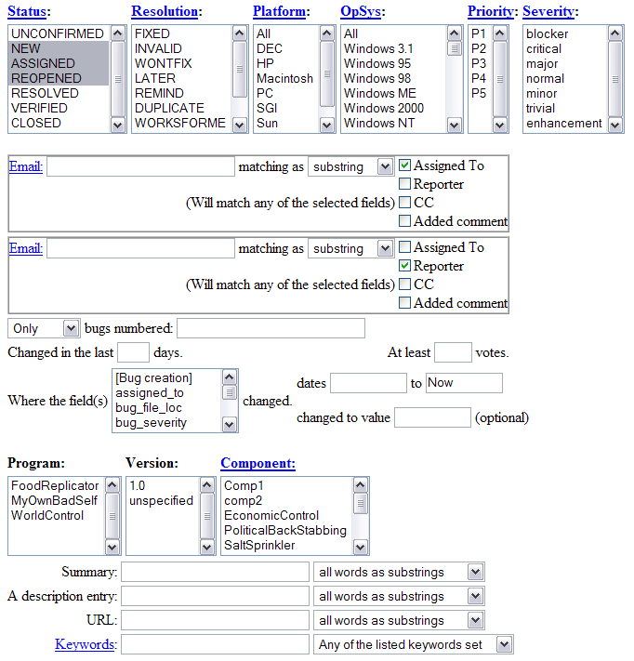
Sample Web Query Form
Change Management and Software Configuration Management

Slide 89
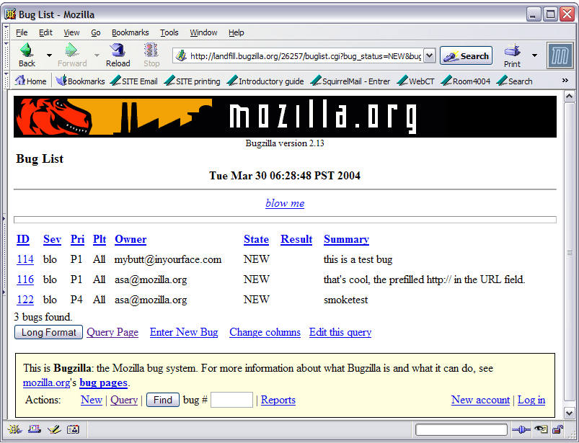
Query Result
Change Management and Software Configuration Management

Slide 90
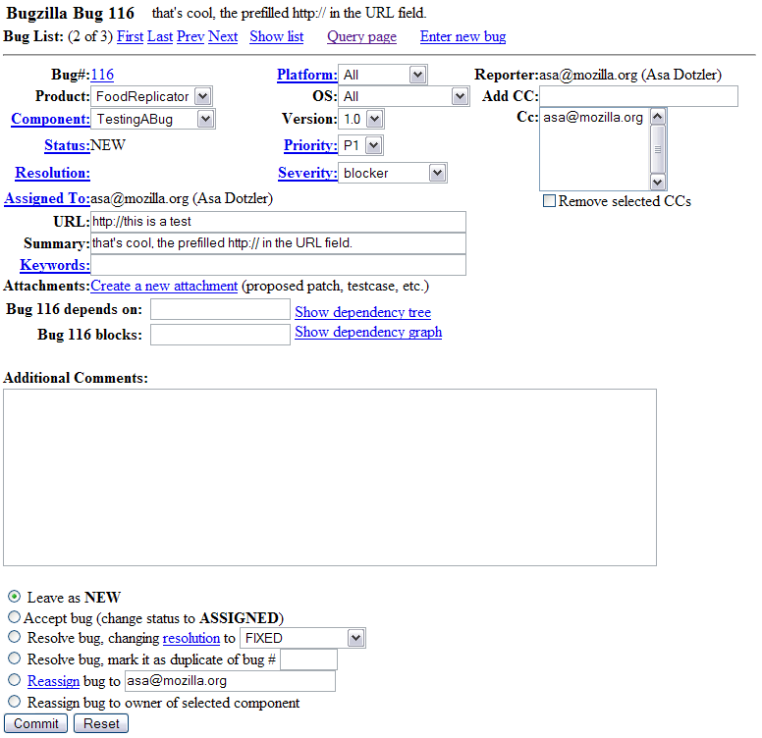
Sample Bug Description
Change Management and Software Configuration Management

Slide 91
Bugzilla References
  http://bugzilla.org/
  Online Documentation:
    http://bugzilla.org/documentation.html
  Who is using Bugzilla?
    http://www.bugzilla.org/installation-list/
Change Management and Software Configuration Management

Slide 92
Summary
Software Configuration Management
  Important part of project management to manage evolving software systems and coordinate changes to them.
Software Configuration Management consists of several activities:
  Promotion and Release management (covered here)
  Branch, Variant and Change Management (see [Bruegge-Dutoit])
Public standard for SCM plans: IEEE 828.
The standard can be tailored to a particular project:
  Large projects need detailed plans to be successful
  Small projects should not be burdened with the bureaucracy of detailed SCM plans
SCM should be supported by tools. These range from
  Simple version storage tools
  Sophisticated systems with automated procedures for policy checks and support for the creation of SCM documents.
Change Management and Software Configuration Management

